Slide 1
ASL Fingerspelling Interpretation
By, Abu
Balaji
Chokkalingam
Kenneth
Viknesh

Slide 2
Introduction
American Sign Language (ASL) is a communication method that is used by hearing impaired individuals to communicate with each other.
It is however a challenge for them to communicate with others who are not familiar with this form of communication.
There are 24 static and 2 two translational hand gestures to differentiate between the 26 letters in the english alphabet.
We would like to employ deep-learning based methods to automatically classify between the different static gestures.

Slide 3
Introduction
Existing work focuses on feature extraction from cropped and segmented images and training a KNN model to perform classification based on these features.
These methods are however dependent on illumination and scaling of the image
We can further expand this research to work on communicating with intelligent machines using hand gestures.

Slide 4
Existing Work
Two main tasks used to accomplish objective (https://web.stanford.edu/class/ee368/Project_Autumn_1617/Proposals/proposal_ranmuthu_ewald_patil.pdf)
Feature Extraction
Histogram of centroid distances
Gabor Filters
Surf & Bag of Words
Hand Model
Skin Segmentation
Classification
K- Nearest Neighbour
Support Vector Machines
Discriminant Analysis

Slide 5
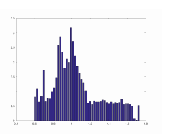
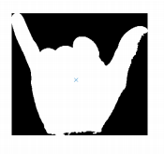
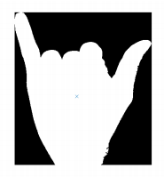
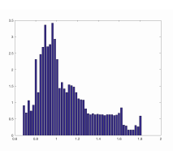
Histogram of Centroid Distances

Slide 6
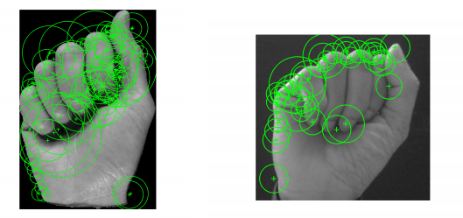
Finding Touch Points with SURF

Slide 7
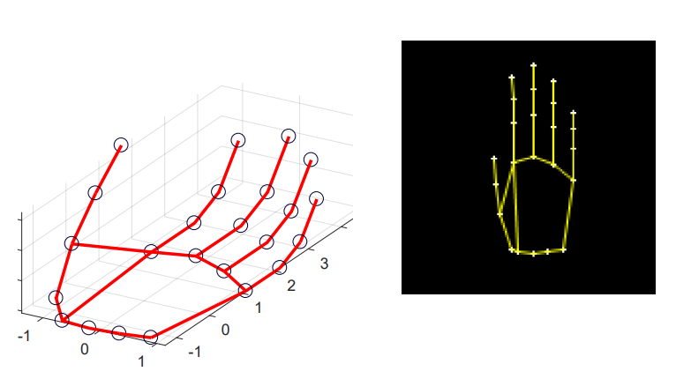
Hand Model

Slide 8
Literature Review
"Real-time hand gesture recognition using finger segmentation" in The Scientific World Journal
The hand region is extracted from the background with the background subtraction method and the palm and fingers are segmented.
a rule classifier is applied to predict the labels of hand gestures.
“A rule classifier is applied to predict the labels of hand gestures.” in 2016 IEEE International Conference on Consumer Electronics-Asia (ICCE-Asia)
A cost-effective, effective framework that translates sign language into voice language and voice language into sign language in real time using a kinect sensor

Slide 9
Literature Review
“A mobile application of American sign language translation via image processing algorithms” in 2016 IEEE Region 10 Symposium (TENSYMP)
sign language translator applied on the smartphone platform, due to its portability and ease of use
Feature points are then extracted with Speeded Up Robust Features (SURF) algorithm, whose features are derived through Bag of Features (BoF).
“Sign Language Classification Using Webcam Images” in stanford.edu
Use custom set of features to classify hand gestures using gaussian kernel SVM.

Slide 10
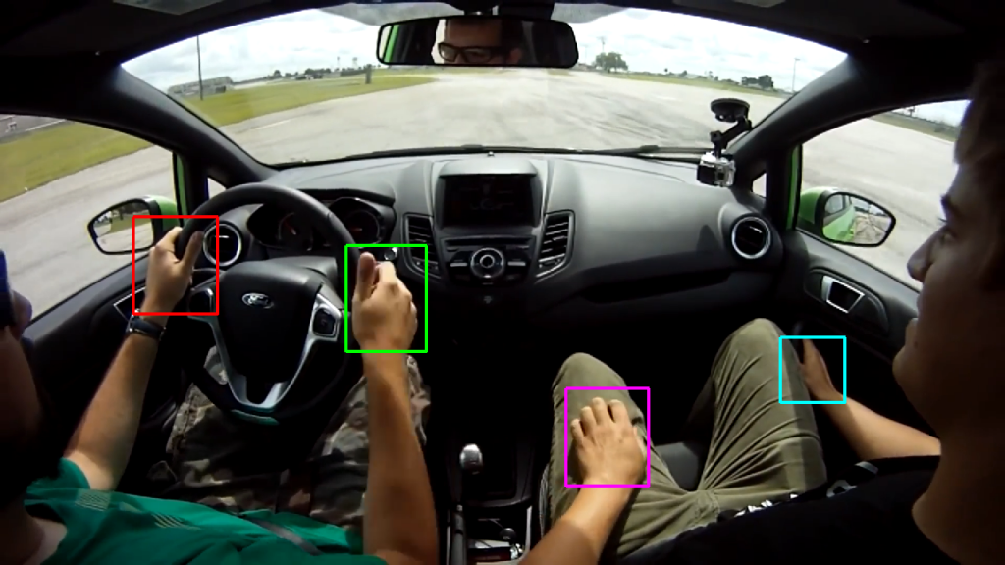
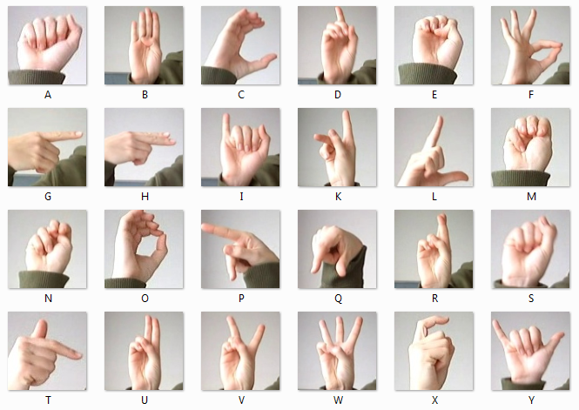
Data
Two set of dataset will be used to build the system:
This Dataset helps us to train a model to detect the coordinate of the hand from external position.
(http://www.robots.ox.ac.uk/~vgg)
This Dataset helps us to train a model which will classify the extracted hand image segments into different letters.
(www.kaggle.com/datamunge/sign-language-mnist)

Slide 11


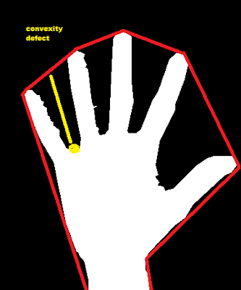
Preprocessing
Hand Detection
Contour Detection
Convex defect
Thresholding

Slide 12
Challenges
Has to be implemented using simple hardware like webcam and mobile camera.
Kinect system and time-of-flight sensor can not be used, as it would reduce widespread adaptability.
There is a need for a robust system in place to handle variable background.
Need to handle the trade off between time to response and accuracy.

Slide 13
Architecture – Current
Capture the ASL Image
Threshold Segment & Croping
Extract Gabor Features
Extract HOCD Features
Classify Using KNN model
Display the predicted letter

Slide 14
Architecture – Proposed
Capture the ASL Image
Hand Detection in image
Threshold /Contour Detection
Finding convexity Defect
Classify Using SVM model
Display the predicted letter

Slide 15
Thank You

